Slide 1
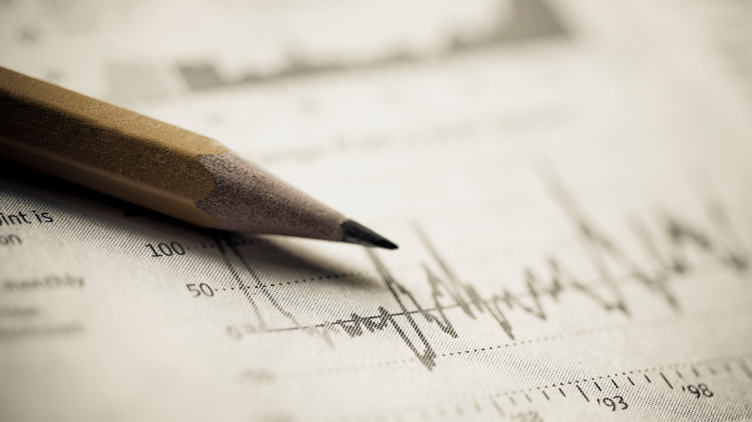
Social Activity
D Joshua Daniel 7C Roll no 11

Slide 2
The task:
“Imagine you’re the ruler of a country. In the present situation, without considering COVID19, what are the three political reforms that you would make? Justify the genuine need for those reforms.”

Slide 3
The reforms:
Field | Education | Employment | Medicine
Reform | Schools would have the same syllabus all over the country. English would be the medium of instruction, National and State language made compulsory. In-service, on-service training would be provided. | At the least one person would be employed in a government organization based on the qualification. | There would be no demarcation between the treatment and services provided in private and government hospitals. Hygiene would be constantly monitored.
Reason | Education is the tool, which once given, cannot be taken, and can be used to change the world. It also increases the economical growth in a country. | When education is taken as a parameter for employment, and quality education is provided at a low cost, it would lead to abolition of illiteracy. | One of the most important industries in life, this determines the health of the country. And, when government facilities are good, it invokes a great amount of money.

Slide 4
Thanks for watching!
D Joshua Daniel Class 7 Section ’C’ Roll No. 11
Chinmaya Vidyalaya CBSE, Coimbatore.

